Slide 1

Made by: Keseli Timur, Zakharov Artem and Shatalov Andrew

Slide 2
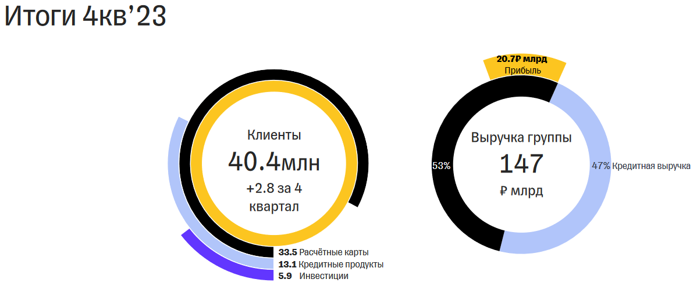
North Star metric
Number of monthly active users!
Reasons:
Half of all profit comes from credit payoffs
Strong correlation with the total deposits in the bank
Useful for sticky factor

Slide 3
Monthly Active Users
Average Bill
Number of Accounts
Product
Average Time Spent on App
Average Number of Transactions
CLV
Service Delivery Excellence
Number of Transactions per day
Operations
Average Transaction Time
Rate of Incident Resolution
Customer Satisfaction Rate
Service Quality
Customer Support
Resolution Effectiveness
Customer Acquisition Rate
Marketing Campaign Efficacy
Marketing
Brand Engagement
Conversion Rate
Return on Assets
Annual Recurring Revenue
Finance
Management costs
Annual Revenue Growth

Slide 4
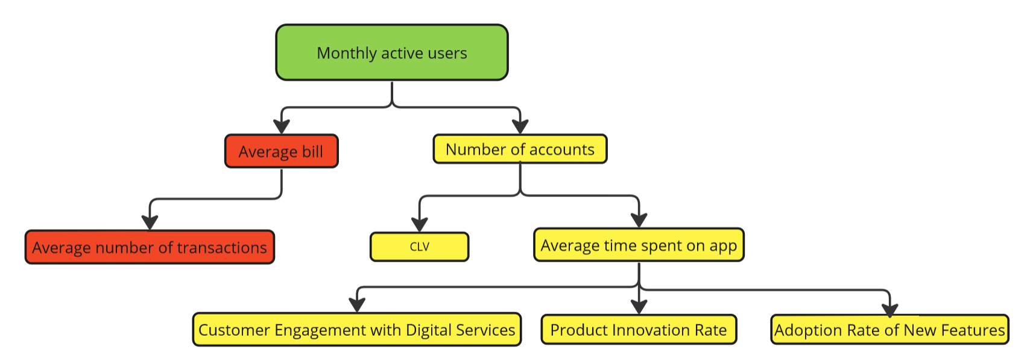
Product hierarchy

Slide 5
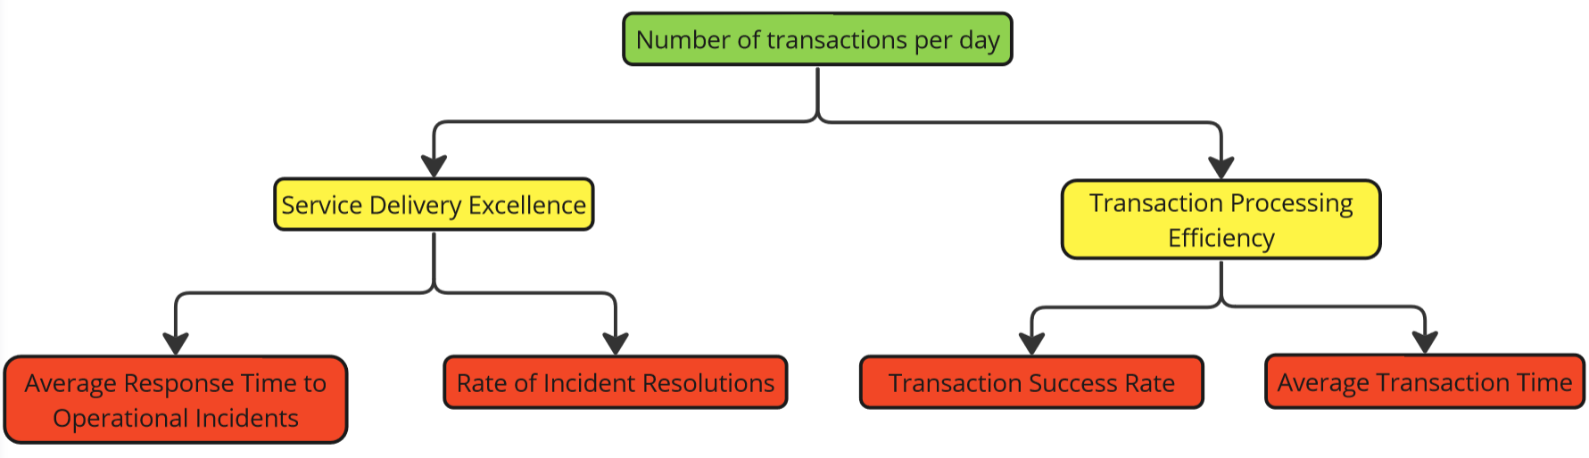
Operations hierarchy

Slide 6
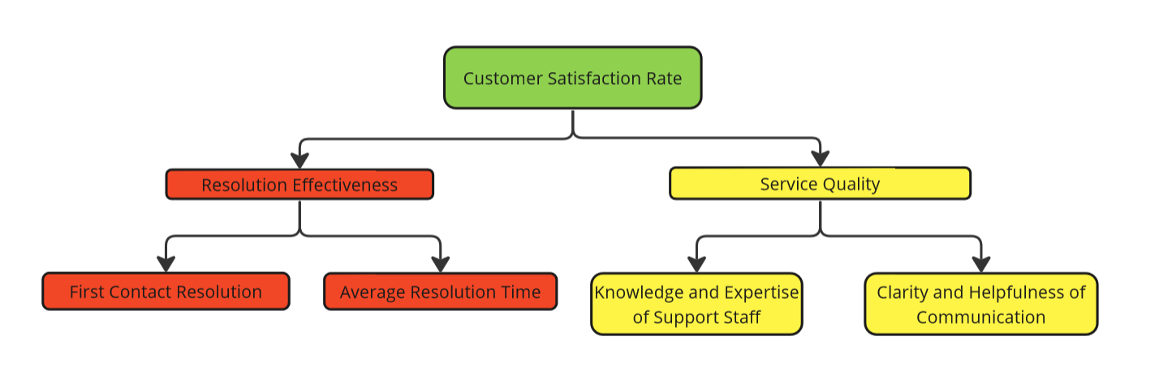
Customer Support hierarchy

Slide 7
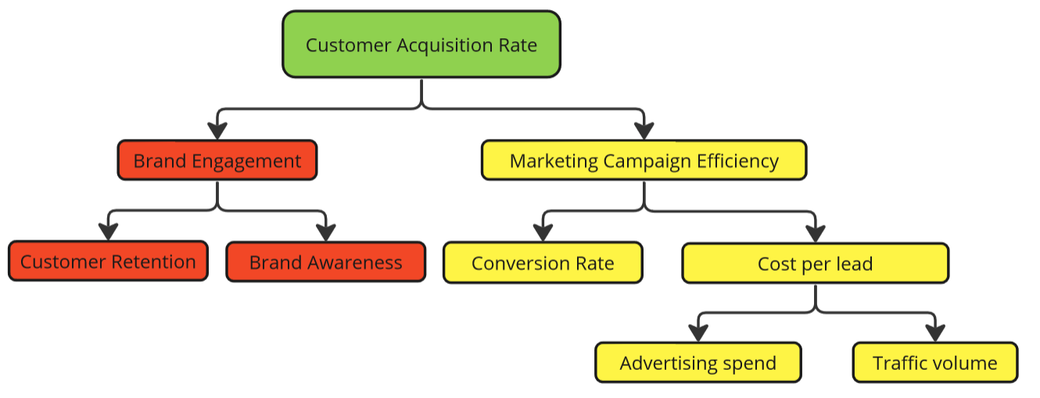
Marketing hierarchy

Slide 8
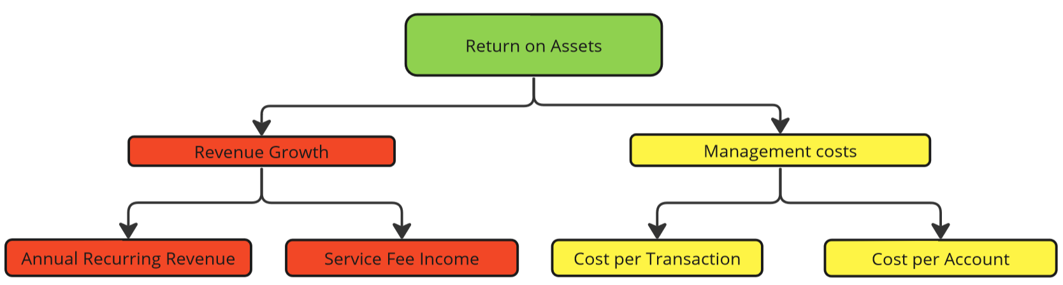
Finance hierarchy

Slide 9
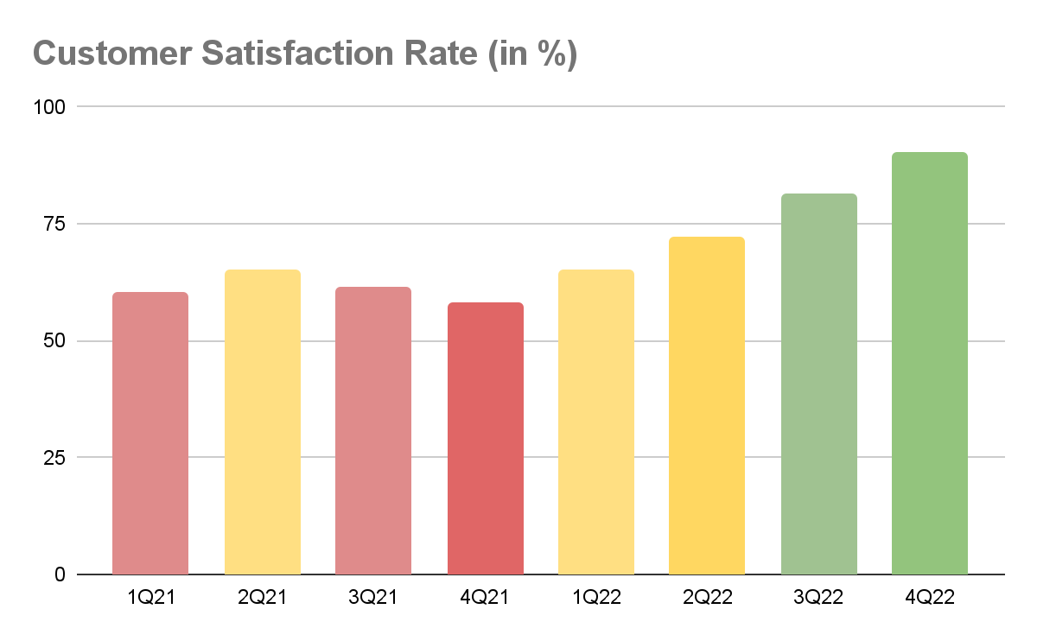
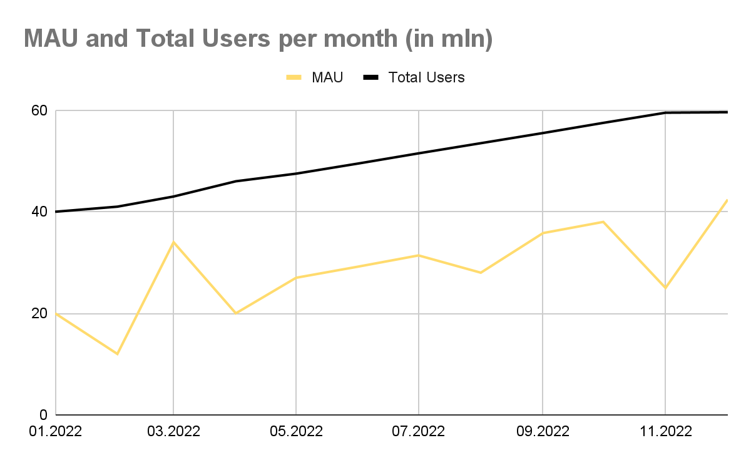
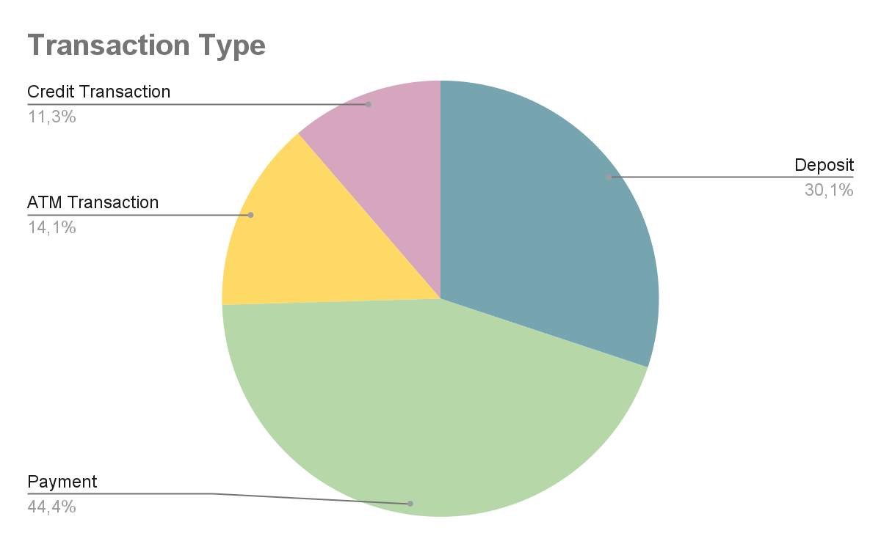
Examples of charts

